Slide 1
Intro to R
R Workshop
February 3, 2021 Prepared by Jay Cao / TDMDAL
Website: https://tdmdal.github.io/r-intro-rbac-2021-winter/

Slide 2


What’s R?
R = a language + an eco-system
A free and open-source programming language
An eco-system of many high-quality user-contributed libraries/packages
In the past R is mostly known for its statistical analysis toolkits
Nowadays R is capable of (and very good at) many other tasks
Tools that cover the whole data analysis workflow
Tools for web technology…

Slide 3
What can R do – Statistics & related
Statistics & Econometrics
Regressions
Time series analysis
Bayesian inference
Survival analysis
…
Numerical Mathematics
Optimization
Solver
Differential equations
…
Finance
Portfolio management
Risk management
Option pricing
…
…
See more R Finance and Risk Management Packages on R Task View - Finance

Slide 4
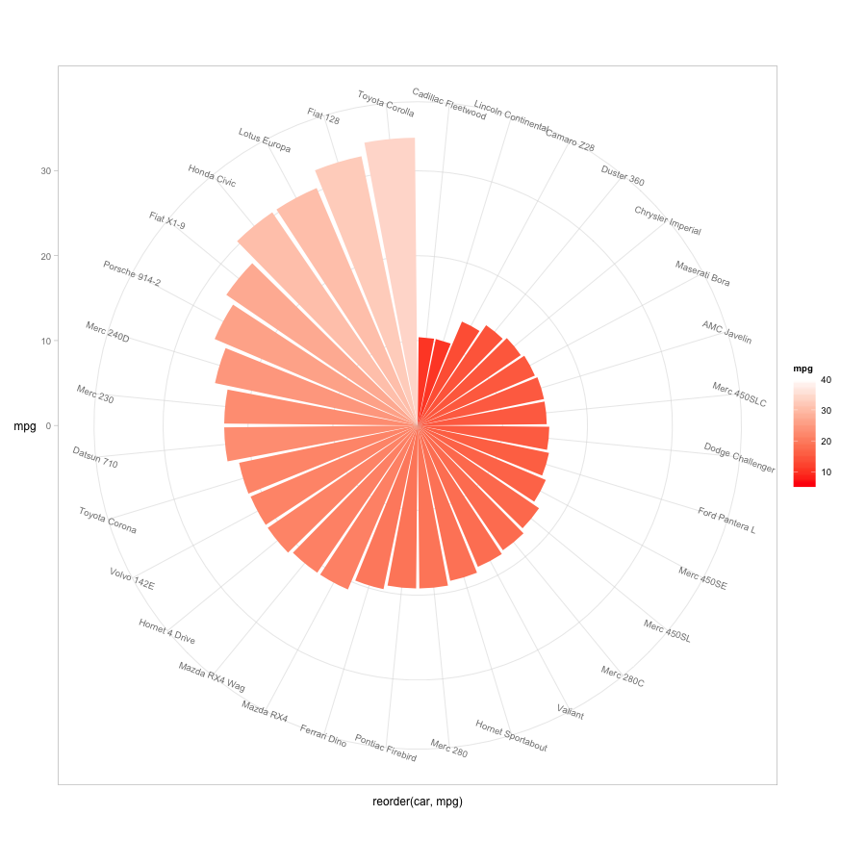
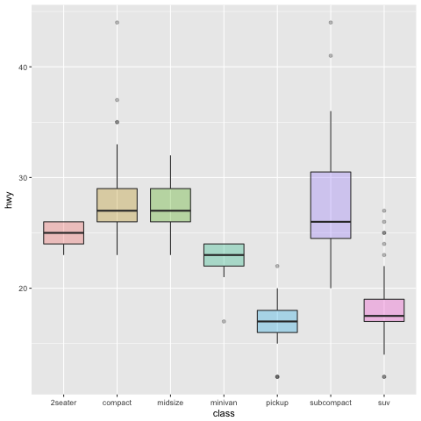
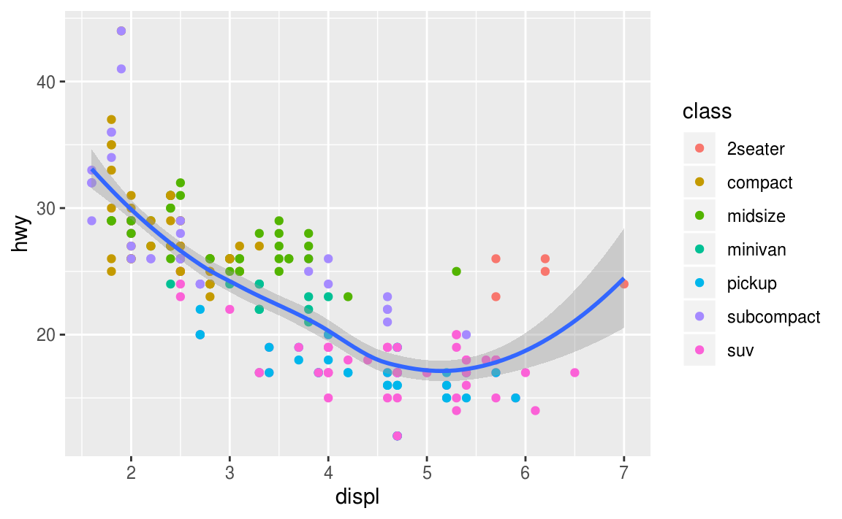
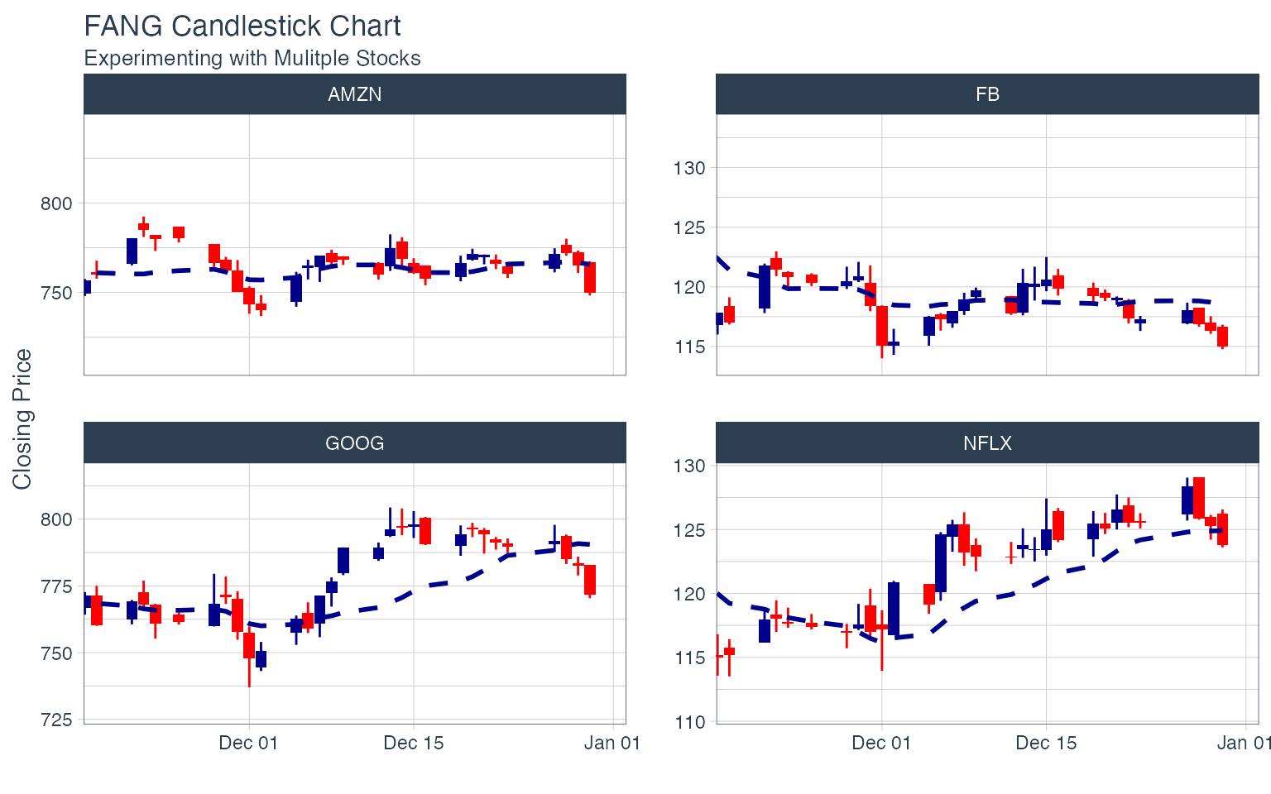
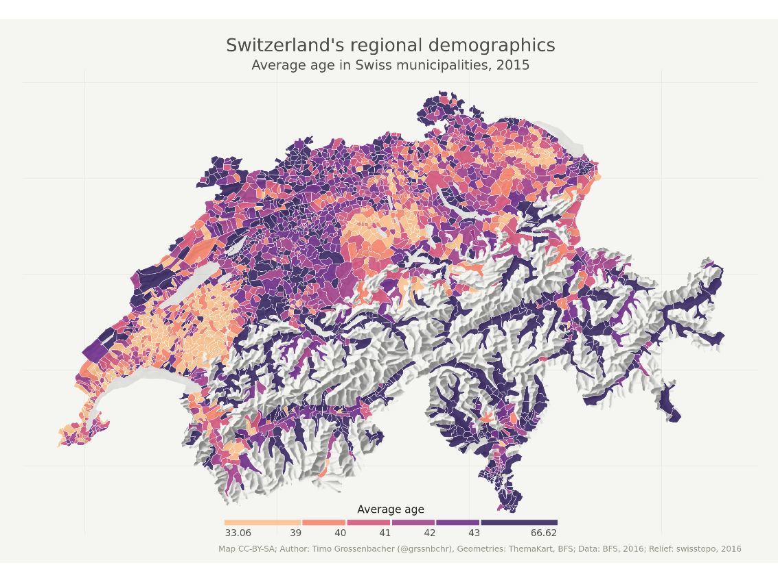
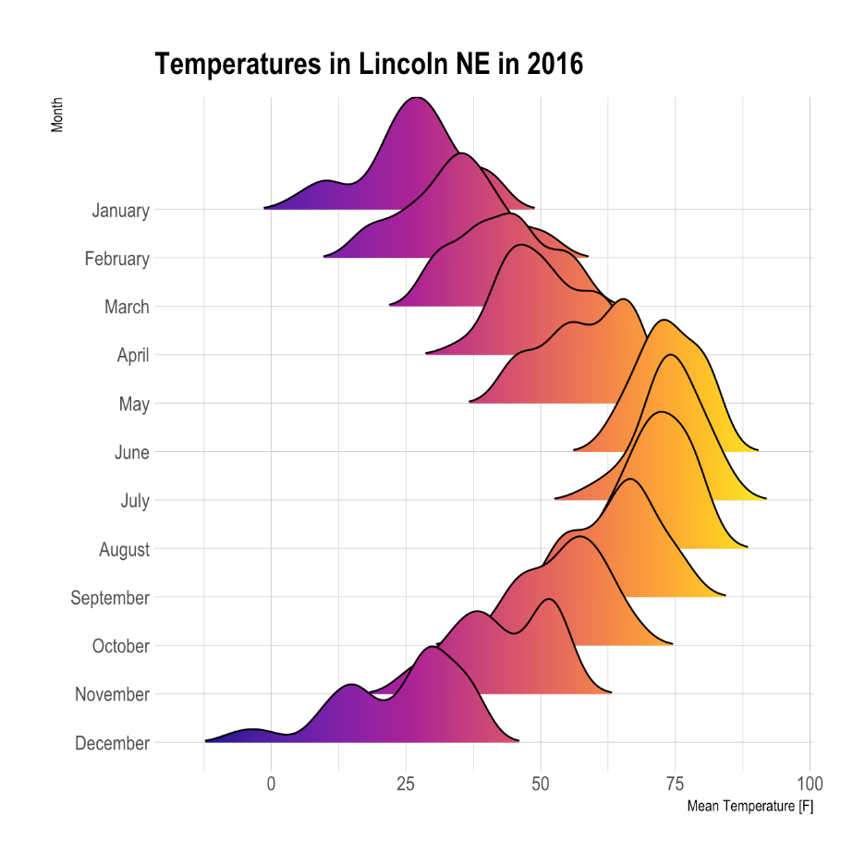
What can R do – Graphics (static ones)
…
https://www.r-graph-gallery.com/
https://timogrossenbacher.ch/2016/12/beautiful-thematic-maps-with-ggplot2-only/;

Slide 5
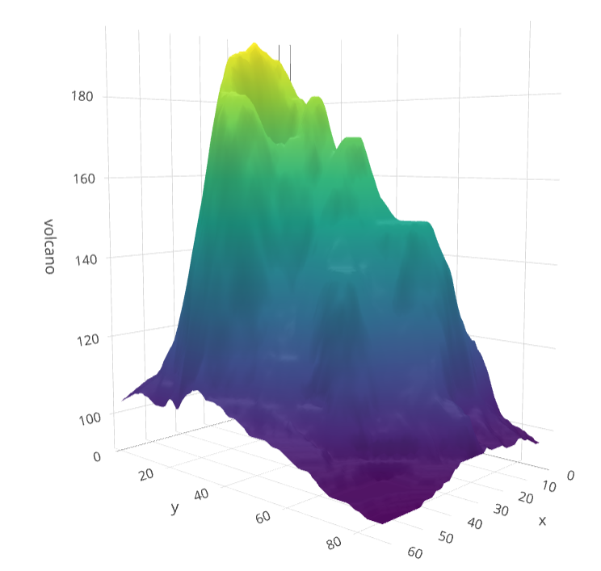
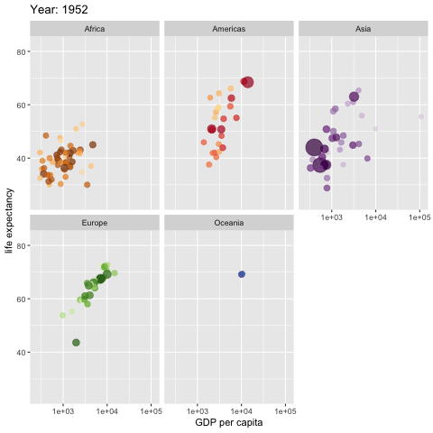
What can R do – Graphics (dynamic ones)
https://plot.ly/r/3d-surface-plots/; https://github.com/thomasp85/gganimate;

Slide 6
What can R do – Others
Machine learning (e.g. interface to Keras and Tensorflow)
Natural language processing (e.g. tidytext, topicmodels)
Web technology
Web scraping (e.g. rvest)
API wrapper (e.g. Twitter: rtweet; bigquery: bigrquery; Quandl: Quandl)
Shiny web app (https://shiny.rstudio.com/)
Reporting
R Markdown (write reports, slides, blogs, books, etc. See a gallery here.)
… (see R Task View for more)

Slide 7
Why learn R (What can R do for You)?
Beyond Excel Data Analysis
I wish Excel could…
Automate boring repeating tasks
e.g., daily data collection from different sources, weekly dashboard update
Prototype ideas
e.g., a novel trading strategy, a new credit risk model
Really, find anything that interests you and use R…

Slide 8
Plan for the 4 Sessions
Overview
Data Manipulation
Graphs
Time Series & Finance Applications

Slide 9
Our Learning Approach – We Will Focus on
Basics
e.g., R’s basic data and programing structures
Underlying principles
e.g., why organize data in a certain way (tidy data)
Best practices
e.g., follow a consistent analysis workflow, and use R packages with consistent design, grammar and data structures

Slide 10
Plan for Today
Preparation and motivation examples
Setup R
Overview of data analysis workflow
Motivation examples
Basics of R language
Walk-through of a typical analysis workflow

Slide 11
Setup R
R on your computer
Install R (https://www.r-project.org/)
Install RStudio (https://rstudio.com/products/rstudio/download/)
R in Cloud (run R without installation)
RStudio Cloud (https://rstudio.cloud/)
Google Colab (https://colab.to/r)

Slide 12

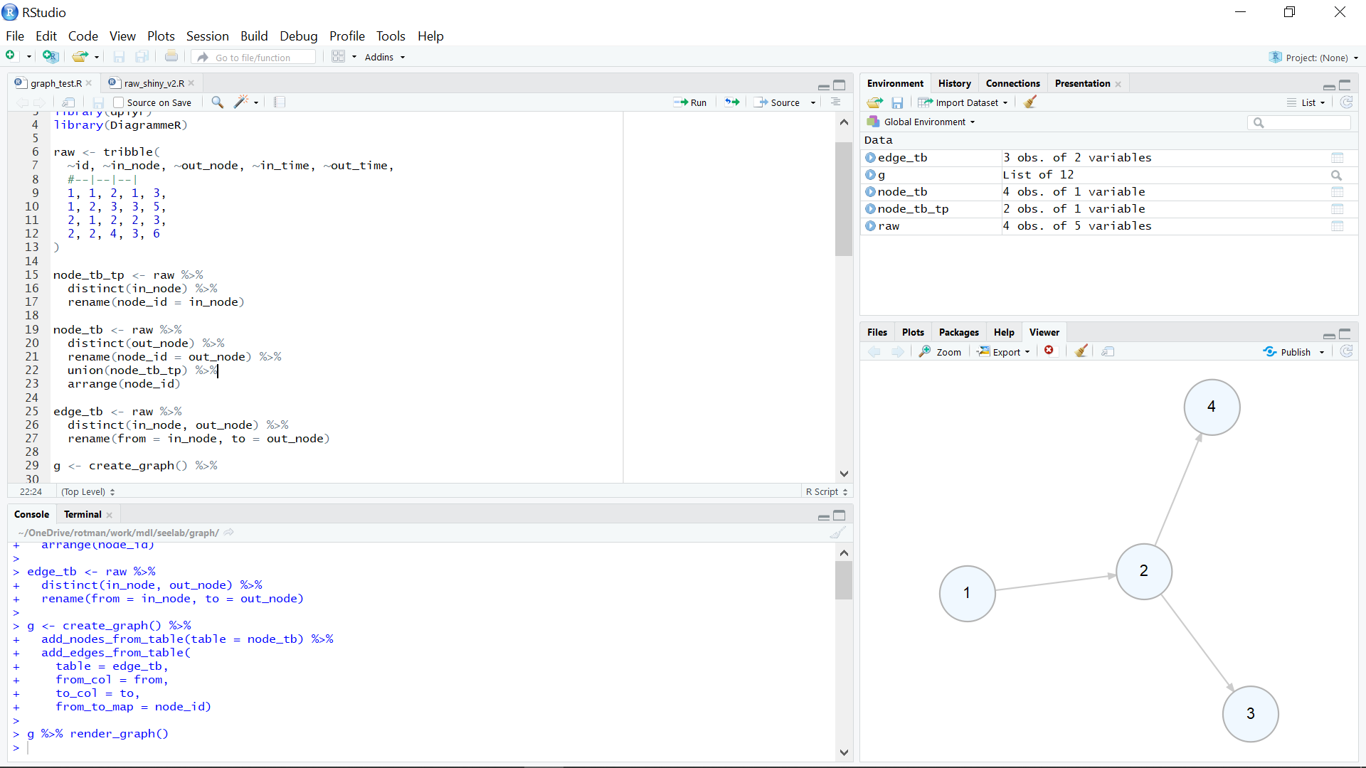
What’s RStudio?

Slide 13
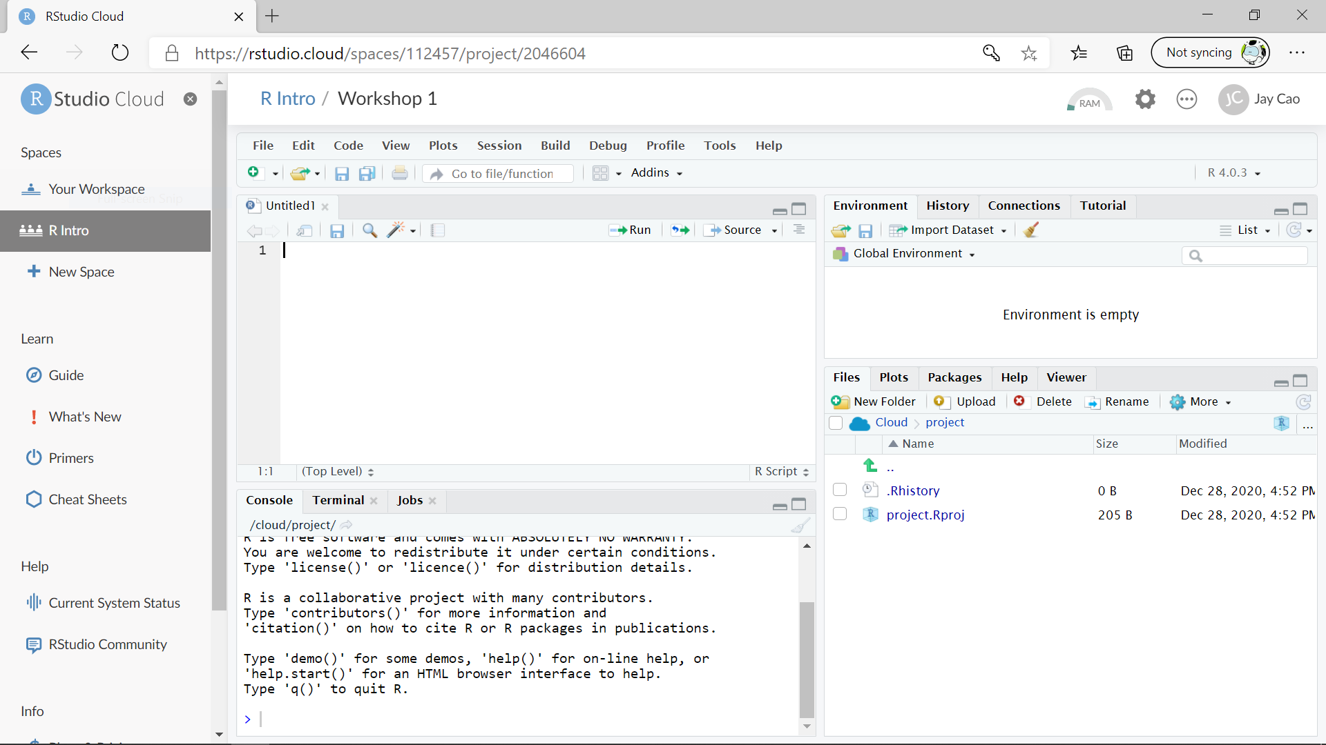
RStudio Cloud

Slide 14

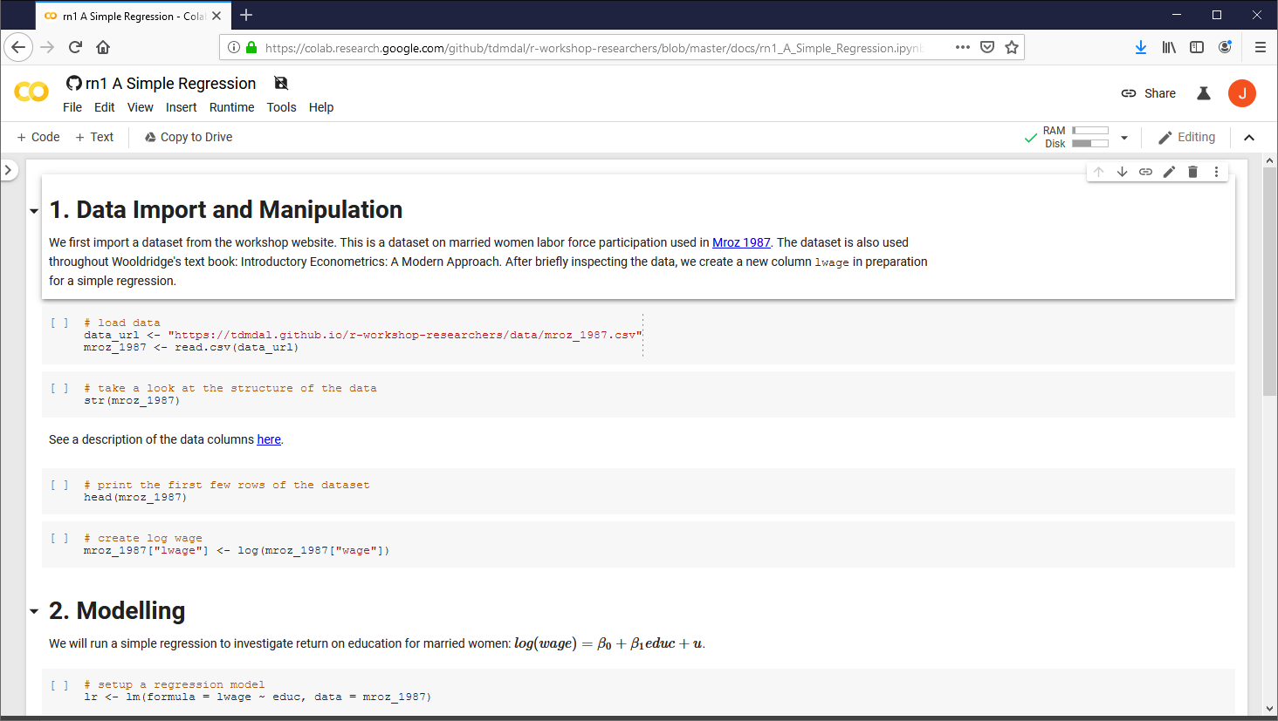
Google Colab

Slide 15

Data Analysis Workflow
https://r4ds.had.co.nz/introduction.html

Slide 16





A Few Examples
Housing prices and clean air - a simple regression analysis
Analyze portfolio performance
Look for trends in R community through Twitter
Recognize handwritten digits - an example of deep learning
PerformanceAnalytics
Package

Slide 17
A Few Examples: What to Look For
Focus on analysis workflow (by reading the code comments)
What data are imported; where are the data located
What data wrangling tasks are performance
What model is applied
What report and visualization are produced
Don’t focus on R syntax
Do notice everything is done in a sequential way
no conditional branching or looping

Slide 18
Plan for Today
Intro to Intro
Basics of R language
Expressions and assignment
Data structure
Programming structure
Walk-through of a typical analysis workflow

Slide 19
Expression and Assignment
# expression
2 + sqrt(4) + log(exp(2)) + 2^2
# assignment
x <- 3
y <- (pi == 3.14)

Slide 20
R Data Structure - Overview
 | Homogeneous | Heterogeneous
1-d | Atomic vector | List
2-d | Matrix | Data frame
n-d | Array
http://adv-r.had.co.nz/Data-structures.html

Slide 21
R Data Structure - Overview
 | Homogeneous | Heterogeneous
1-d | Atomic vector | List
2-d | Matrix | Data frame
n-d | Array
http://adv-r.had.co.nz/Data-structures.html

Slide 22
Atomic Vectors
# create R vectors
vec_character <- c("Hello,", "World!")
vec_integer <- c(1L, 2L, 3L)
vec_double <- c(1.1, 2.2, 3.3)
vec_logical <- c(TRUE, TRUE, FALSE)
Hello, | World!
1 | 2 | 3
1.1 | 2.2 | 3.3
TRUE | TRUE | FALSE

Slide 23
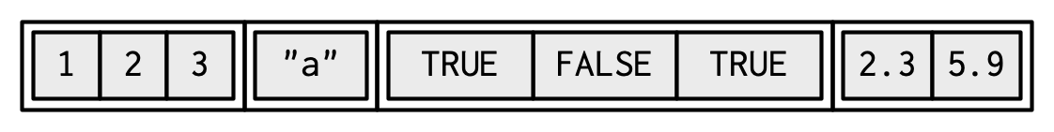
List
# create an R list
l1 <- list(
1:3,
"a",
c(TRUE, FALSE, TRUE),
c(2.3, 5.9)
)
ref. https://adv-r.hadley.nz/vectors-chap.html#list-creating

Slide 24
Data Frame
# create a data frame
df1 <- data.frame(
x = 1:3,
y = letters[1:3],
z = c(1.1, 2.2, 3.3)
)
x | y | z
1 | "a" | 1.1
2 | "b" | 2.2
3 | "c" | 3.3

Slide 25
Data Frame
# create a data frame
df1 <- data.frame(
x = 1:3,
y = letters[1:3],
z = c(1.1, 2.2, 3.3)
)
x | y | z
1 | "a" | 1.1
2 | "b" | 2.2
3 | "c" | 3.3

Slide 26
Data Frame
# create a data frame
df1 <- data.frame(
x = 1:3,
y = letters[1:3],
z = c(1.1, 2.2, 3.3)
)
x | y | z
1 | "a" | 1.1
2 | "b" | 2.2
3 | "c" | 3.3

Slide 27
Tibble – A Cousin to Data Frame
# load tibble library (part of tidyverse lib)
library(tibble)
# create a tibble
tb1 <- tibble(
x = 1:3,
y = letters[1:3],
z = c(1.1, 2.2, 3.3)
)
x | y | z
1 | "a" | 1.1
2 | "b" | 2.2
3 | "c" | 3.3
https://r4ds.had.co.nz/tibbles.html#tibbles-vs.data.frame

Slide 28
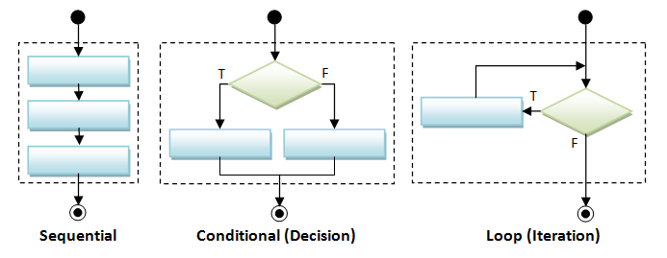
Programming Structure: Control Flows

Slide 29
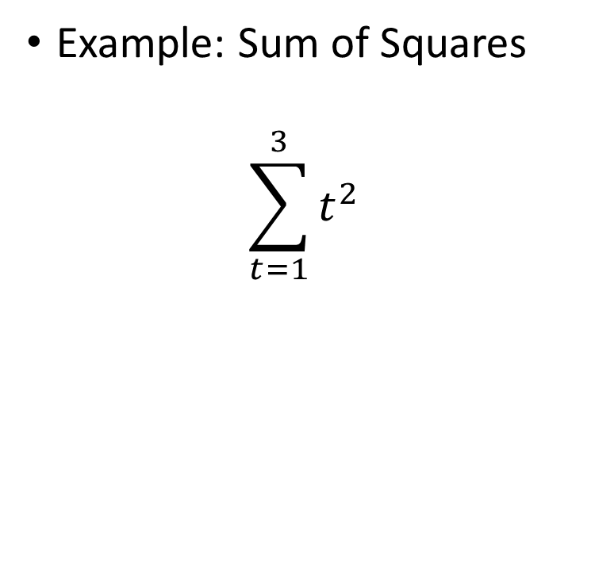
Sequential
Example: Sum of Squares
$$\sum_{t=1}^{3}{t^{2}}$$
# sum of squares
t <- 1:3
y <- sum(t^2)
print(y)

Slide 30
Sequential
Example: Sum of Squares
$$\sum_{t=1}^{3}{t^{2}}$$
# sum of squares
t <- 1:3
y <- sum(t^2)
print(y)
t
1 | 2 | 3

Slide 31
Sequential
Example: Sum of Squares
$$\sum_{t=1}^{3}{t^{2}}$$
# sum of squares
t <- 1:3
y <- sum(t^2)
print(y)
t
1 | 2 | 3
t^2
1 | 4 | 9
sum(t^2)
14

Slide 32
Conditional (if…else…)
if (cond) {
# run here if cond is TRUE
} else {
# run here if cond is FALSE
}
# y greater than 10?
if (y > 10) {
print("greater than 10")
} else {
print("less or equal to 10")
}

Slide 33
Conditional (if…else…)
if (cond) {
# run here if cond is TRUE
} else {
# run here if cond is FALSE
}
# y greater than 10?
if (y > 10) {
print("greater than 10")
} else {
print("less or equal to 10")
}
T
y>10?
F
“great…”
“less…”

Slide 34
Conditional (if…else if…else…)
if (cond1) {
# run here if cond1 is TRUE
} else if (cond2) {
# run here if cond1 is FALSE but cond2 is TRUE
} else {
# run here if neither cond1 nor cond2 is TRUE
}

Slide 35
Iteration
for (var in seq) {
do something
}
while (cond) {
do something if cond is TRUE
}
# sum of squares
t <- 1:3
y <- 0
for (x in t) {
y <- y + x^2
}
print(y)

Slide 36
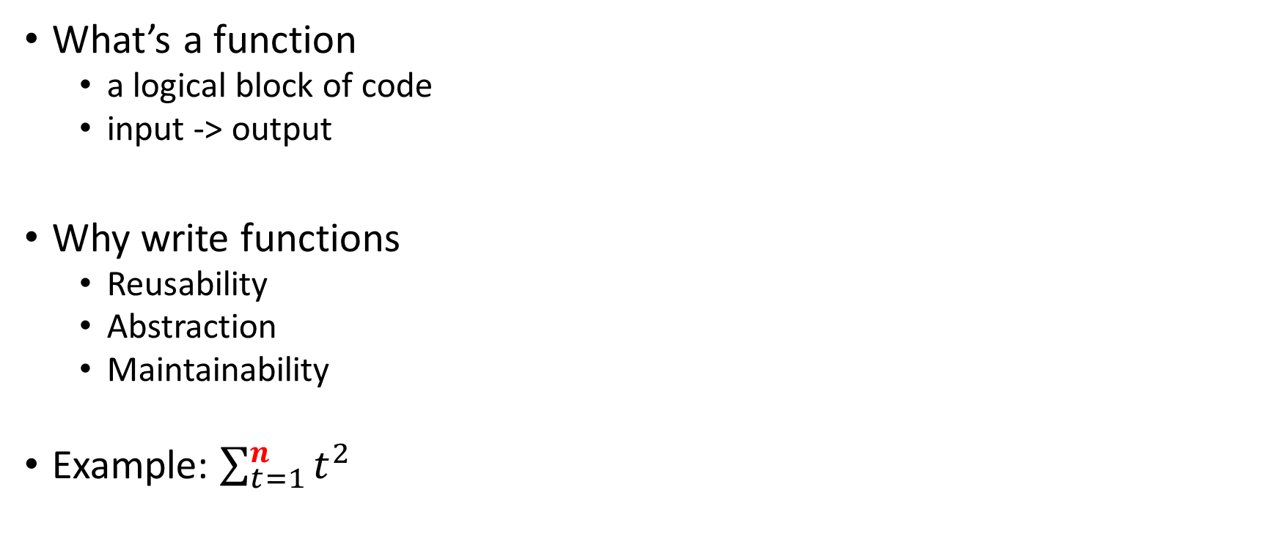
Programming Structure: Functions
# sum of squares from 1 to n
ss <- function(n) {
t <- 1:n
sum(t^2)
}
# calling the ss() function
print(ss(2))
print(ss(3))
What’s a function
a logical block of code
input -> output
Why write functions
Reusability
Abstraction
Maintainability
Example: $\sum_{t=1}^{n}{t^{2}}$

Slide 37
Programming Structure: Functions
# sum of squares from 1 to n
ss <- function(n) {
t <- 1:n
sum(t^2)
}
# calling the ss() function
print(ss(2))
print(ss(3))
What’s a function
a logical block of code
input -> output
Why write functions
Reusability
Abstraction
Maintainability
Example: $\sum_{t=1}^{n}{t^{2}}$

Slide 38
Programming Structure: Functions
# sum of squares from 1 to n
ss <- function(n) {
t <- 1:n
sum(t^2) # return(sum(t^2))
}
# calling the ss() function
print(ss(2))
print(ss(3))
What’s a function
a logical block of code
input -> output
Why write functions
Reusability
Abstraction
Maintainability
Example: $\sum_{t=1}^{n}{t^{2}}$

Slide 39
Plan for Today
Intro to Intro
Basics of R language
Walk-through of a typical analysis workflow
Import and manipulate data
Build models
Report results

Slide 40
Extending the regression example
Manipulate data
Load data
Create new columns
Filter columns and rows
Build models
Multiple linear regression
Regression with interactive terms
Report and graph
Build a publication-ready table for regression results

Slide 41
Using R libraries
Install and load an R library
install.packages("library_name")
library(library_name)
CRAN (The Comprehensive R Archive Network)
CRAN Task Views

Slide 42
Many choices, which one to use
Often time, many choices of functions/libraries to do one task
R is open and extensible!
Example: load a csv file to a data frame
Use read.csv() function from the utils library
Use read_csv() function from the readr library
Use fread() function from the data.table library
Use vroom() from the vroom library

Slide 43
Many choices, which one to use
Start with the one most people use
Choose one that is well maintained
check document, github, etc. for last update
Choose one that suits your task

Slide 44
Our Choice: extending the regression example
Manipulate data (tidyverse eco-system)
Load data (read_csv() from the readr)
Create new columns (mutate() from dplyr)
Filter columns and rows (select() and filter() from dplyr)
Build models
Multiple regression (lm() from stats library in R base)
Report and graph
Build a publication-ready table (huxreg() from huxtable library)

Slide 45
Load a CSV file
read_csv() from the readr
read_csv(file)
e.g. hprice <- read_csv("hprice.csv")
More about read_csv()
More about readr

Slide 46
Load Data – Other file formats and sources
readxl for Excel sheets
haven for SPSS, Stata and SAS data
jsonlite for JSON
xml2 for XML
httr for web APIs
rvest for web scraping
DBI for connecting to DataBase engine
…

Slide 47
Load Data – Financial Dataset
tq_get() from tidyquant library
collect financial and economic data from many online sources
Yahoo Finance, FRED, Quandl, Tiingo, Alpha Vantage, Bloomberg
simfinR or simfinapi library
download financial statements – balance sheet, cash flow and income statement – and adjusted daily price of stocks through the simfin project
a few others (try to look for them yourselves…)

Slide 48
Data Manipulation: dplyr basics
Filter observations: filter()
Select variables: select()
Reorder rows: arrange()
Create new variables: mutate()
Collapse column values to a single summary: summarise()
Group by: group_by()

Slide 49
Data Manipulation: filter()
filter(my_dataframe, condition1, …)
e.g.
hprice_reg <- filter(hprice, price > 20000)

Slide 50
Data Manipulation: mutate()
mutate(my_dataframe, new_var1 = expression1, …)
e.g.
hprice_reg <- mutate(hprice_reg, lprice = log(price))

Slide 51
Data Manipulation: select()
select(my_dataframe, var1, …)
e.g.
hprice_reg <- select(hprice_reg, lprice, rooms)

Slide 52
Data Manipulation: Data Pipe (%>%)
hprice_reg <- filter(hprice, price > 20000)
hprice_reg <- mutate(hprice_reg, lprice = log(price))
hprice_reg <- select(hprice_reg, lprice, rooms)

Slide 53
Data Manipulation: Data Pipe (%>%)
hprice_reg <- filter(hprice, price > 20000)
hprice_reg <- mutate(hprice_reg, lprice = log(price))
hprice_reg <- select(hprice_reg, lprice, rooms)
hprice_reg <- hprice %>%
filter(., price > 20000) %>%
mutate(., lprice = log(price)) %>%
select(., lprice, rooms)

Slide 54
Data Manipulation: Data Pipe (%>%)
hprice_reg <- filter(hprice, price > 20000)
hprice_reg <- mutate(hprice_reg, lprice = log(price))
hprice_reg <- select(hprice_reg, lprice, rooms)
hprice_reg <- hprice %>%
filter(price > 20000) %>%
mutate(lprice = log(price)) %>%
select(lprice, rooms)

Slide 55
Data Manipulation: Others
Join two data frames
_join() family in dplyr
Reshape data frames
pivot_longer() and pivot_wider() in tidyr

Slide 56
Regression
Multiple regressions: lm() from stats library in base R
my_model <- lm(y ~ x1 + x2, data)
Multiple regressions with interactive terms
my_model <- lm(y ~ x1 + x2 + I(x1 * x2), data)
Regression result summary: summary()
Ref. https://faculty.chicagobooth.edu/richard.hahn/teaching/FormulaNotation.pdf

Slide 57
Report
Summary table
Summary for lm(): summary(my_model)
publication-ready table: huxreg() from huxtable library
huxtable(my_model1, my_model2, …)
Ref. https://hughjonesd.github.io/huxtable/huxreg.html

Slide 58

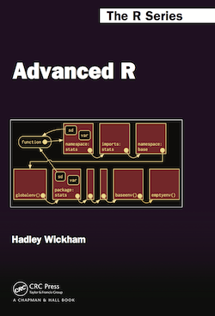
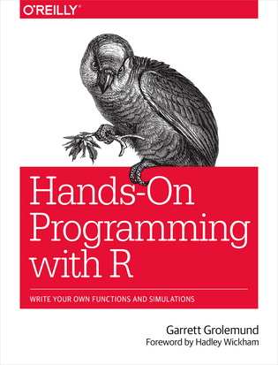
Free Learning Resources - Books
R for Data Science
Advanced R
Hands-On Programming with R
Check bookdown.org often

Slide 59
Free Learning Resources – Video Courses
RStudio Resources Site
Coursera
free for UofT students (mostly always free if you just audit the courses)
Search R and learn

Slide 60
Free Learning Resources – Others
RStudio Education (Choose Your Learning Paths)
CRAN Task View
Twitter (a few seeds: #rstat, @hadleywickham, @WeAreRLadies)

